Slide 1

AI Mini Project
-
Customer Segmentation for Big Bazaar
Submitted by -
Saksham Sohal Abhay Singh Minhas Ashmita
Samaira Nayyar
Swastik Bhanot
1024060114
1024060118
1024060121
1024060080
1024060116
Submitted to -
Prof. Sandeep Mandia

Slide 2
1.
Introduction
2.
Data Pre-Processing and Exploratory Data Analysis
3.
Model Implementation and
Evaluation
4.
Segment Analysis and
Persona Development
Contents

Slide 3


Introduction
In today’s competitive retail landscape, one-size-fits-all marketing no longer works. Big Bazaar serves a diverse customer base, making segmentation essential to avoid wasted resources and missed opportunities. By applying unsupervised machine learning (clustering), we can uncover natural customer groups and define clear personas. This data-driven approach supports smarter, more effective business decisions.

Slide 4

Objectives
Develop a Robust Pre-processing Pipeline:
A key contribution was the establishment of a comprehensive pre-processing methodology.
Conduct a Comparative Analysis of Clustering Algorithms: Rather than relying on a single method, we have used three clustering methods to provide a comparative analysis of three distinct clustering paradigms—K-Means, Hierarchical, and DBSCAN.
Identify and Profile Data-Driven Customer Personas: The central contribution of this work is the successful identification and detailed profiling of six distinct customer personas.
Quantify Model Performance: To validate our findings, we established a rigorous evaluation framework using the Silhouette Score metric, providing a quantitative justification for our final model selection.

Slide 5

Data Pre-Processing and Exploratory Data Analysis
A rigorous pre-processing and exploration phase is essential to ensure the quality of the input data and to gain initial insights into its underlying structure, which in turn leads to a more robust and meaningful clustering model.
Customer ID | Gender | Age | Annual Income(k$) | Spending Score(1-100)
1 | Male | 19 | 15 | 39
2 | Male | 21 | 15 | 81
3 | Female | 20 | 16 | 6
4 | Female | 23 | 16 | 77
5 | Female | 31 | 17 | 40
Sample of the Raw Dataset
The analysis is based on the ”Mall Customer Segmentation” dataset, a publicly available resource from Kaggle.

Slide 6
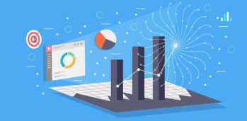
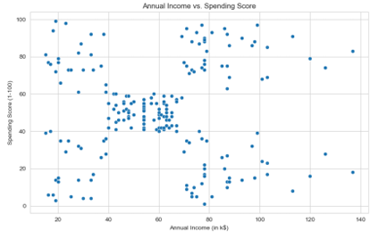
Exploratory Data Analysis (EDA)
The initial phase of EDA was conducted to understand the distributions of the key features and the relationships between them. Histograms revealed that both Annual Income and Spending Score have reasonably normal distributions, indicating a good spread of customer types.

Slide 7
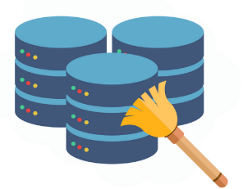
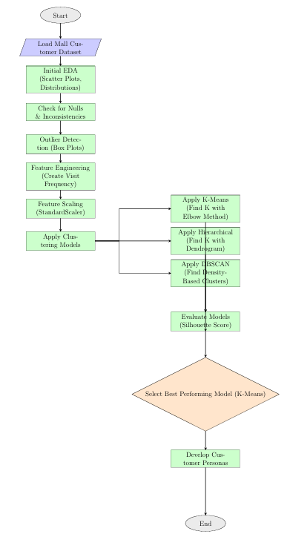
Pre-Processing Pipeline
.
Data Cleaning: Checked for missing/null values using df.info(). All 200 entries were complete, so no imputation or record removal was needed
• Outlier Detection: Box plots showed some high-income outliers. These were retained, as they represent legitimate high-earning customers.
Inconsistency Check: Verified the Gender column for errors. It was consistent, containing only “Male” and “Female.”
Feature Engineering: Created new features – Visit Frequency (monthly visits linked to Spending Score) and Age Groups (e.g., 18–25, 26–40).
Feature Scaling: Standardized Annual Income, Spending Score, and Visit Frequency using Z-score to prevent scale bias in clustering.
z = (x−µ)/ σ

Slide 8
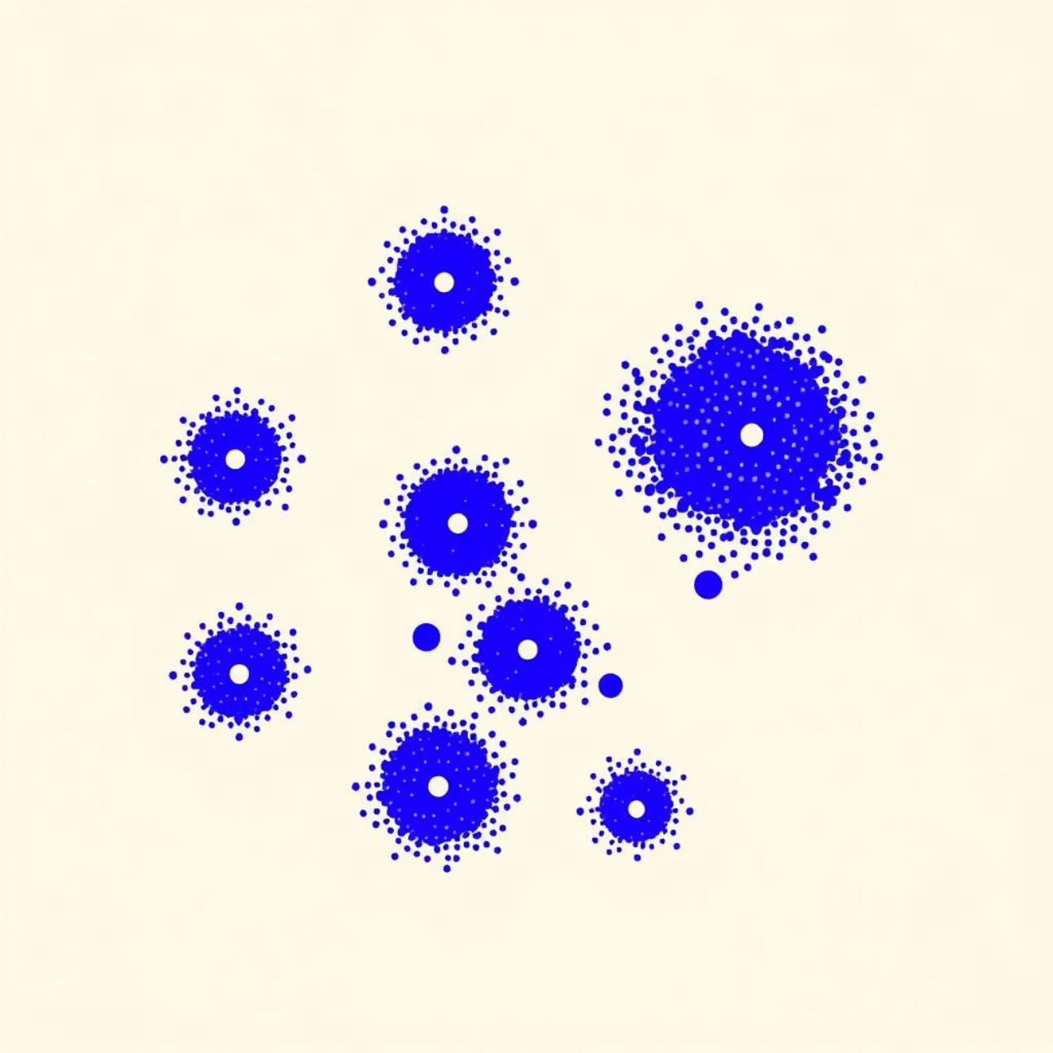
Model Implementation and Evaluation
Clustering Algorithms:
1. K-Means Clustering
An unsupervised algorithm that partitions data into k clusters.
Each point belongs to the cluster with the nearest centroid (mean).
Works iteratively:
assign points → recalculate centroids → repeat until stable.
Groups similar data points based on feature similarity.
Widely used for customer segmentation, data exploration, and pattern discovery.

Slide 9
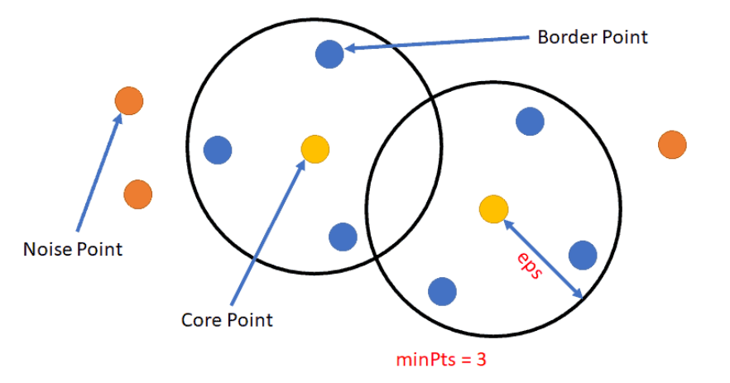
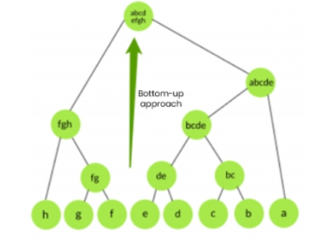
Agglomerative Hierarchical Clustering
A bottom-up clustering method starting with each point as its own cluster.
Iteratively merges the two closest clusters based on distance.
Process continues until all points form one large cluster.
Results are visualized using a dendrogram.
Useful for understanding cluster hierarchy and structure.
Does not require predefining the number of clusters.
DBSCAN
An unsupervised clustering algorithm based on density.
Groups together points that are closely packed within a defined distance (ε).
Requires two parameters: ε (neighborhood radius) and MinPts (minimum points).
Identifies dense clusters of arbitrary shapes.
Marks low-density points as outliers (noise).
Useful for datasets with irregular patterns and anomalies.

Slide 10
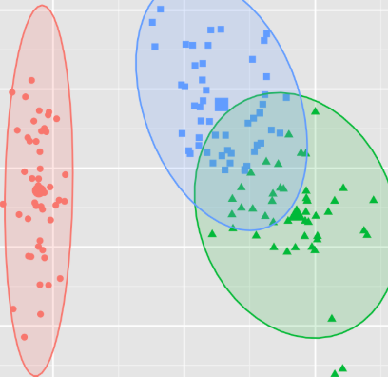
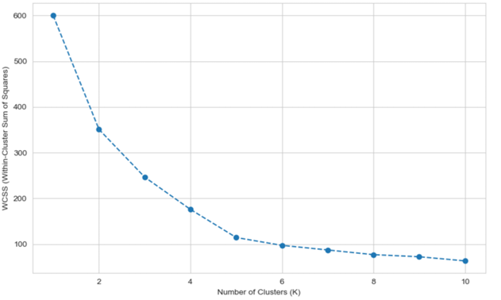
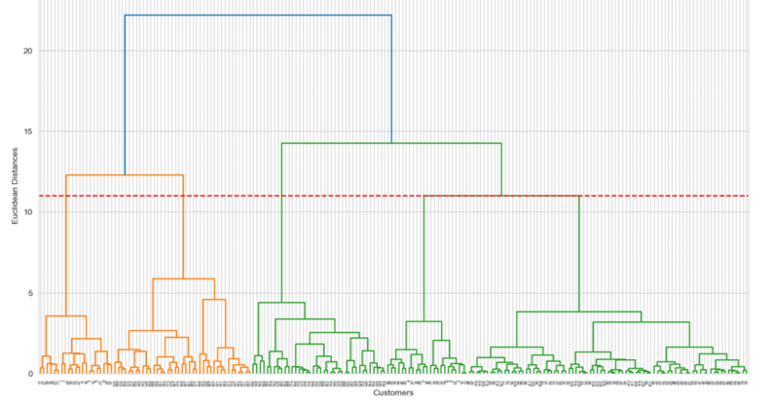
Finding the Optimal Number of Clusters
Elbow Method (For K-Means)
The Dendrogram (Hierarchical Clustering)
The elbow is clearly visible at K=6, suggesting this is the most effective number of segments.
The dendrogram corroborates the finding from the Elbow Method, also strongly suggesting that 6 clusters is the most natural grouping for the data

Slide 11
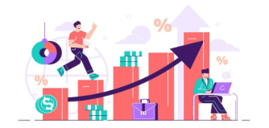
Result and Performance Evaluation
Result:
K-Means & Hierarchical Models: Both algorithms were configured to partition the data into the predetermined 6 clusters.
DBSCAN and Outlier Analysis: The DBSCAN model, operating on density principles, provided a unique and powerful insight. It identified 5 core, dense clusters and classified 44 customers as outliers.
Perfomance (Silhousette Score) :
Model | Silhousette Score | Key Insight
K-Means(k=6) | 0.501 | 6 well-defined clusters
Hierarchical(k=6) | 0.480 | Confirmed 6-cluster structure
DBSCAN | N/A* | Found 5 core groups + 44 outliers

Slide 12
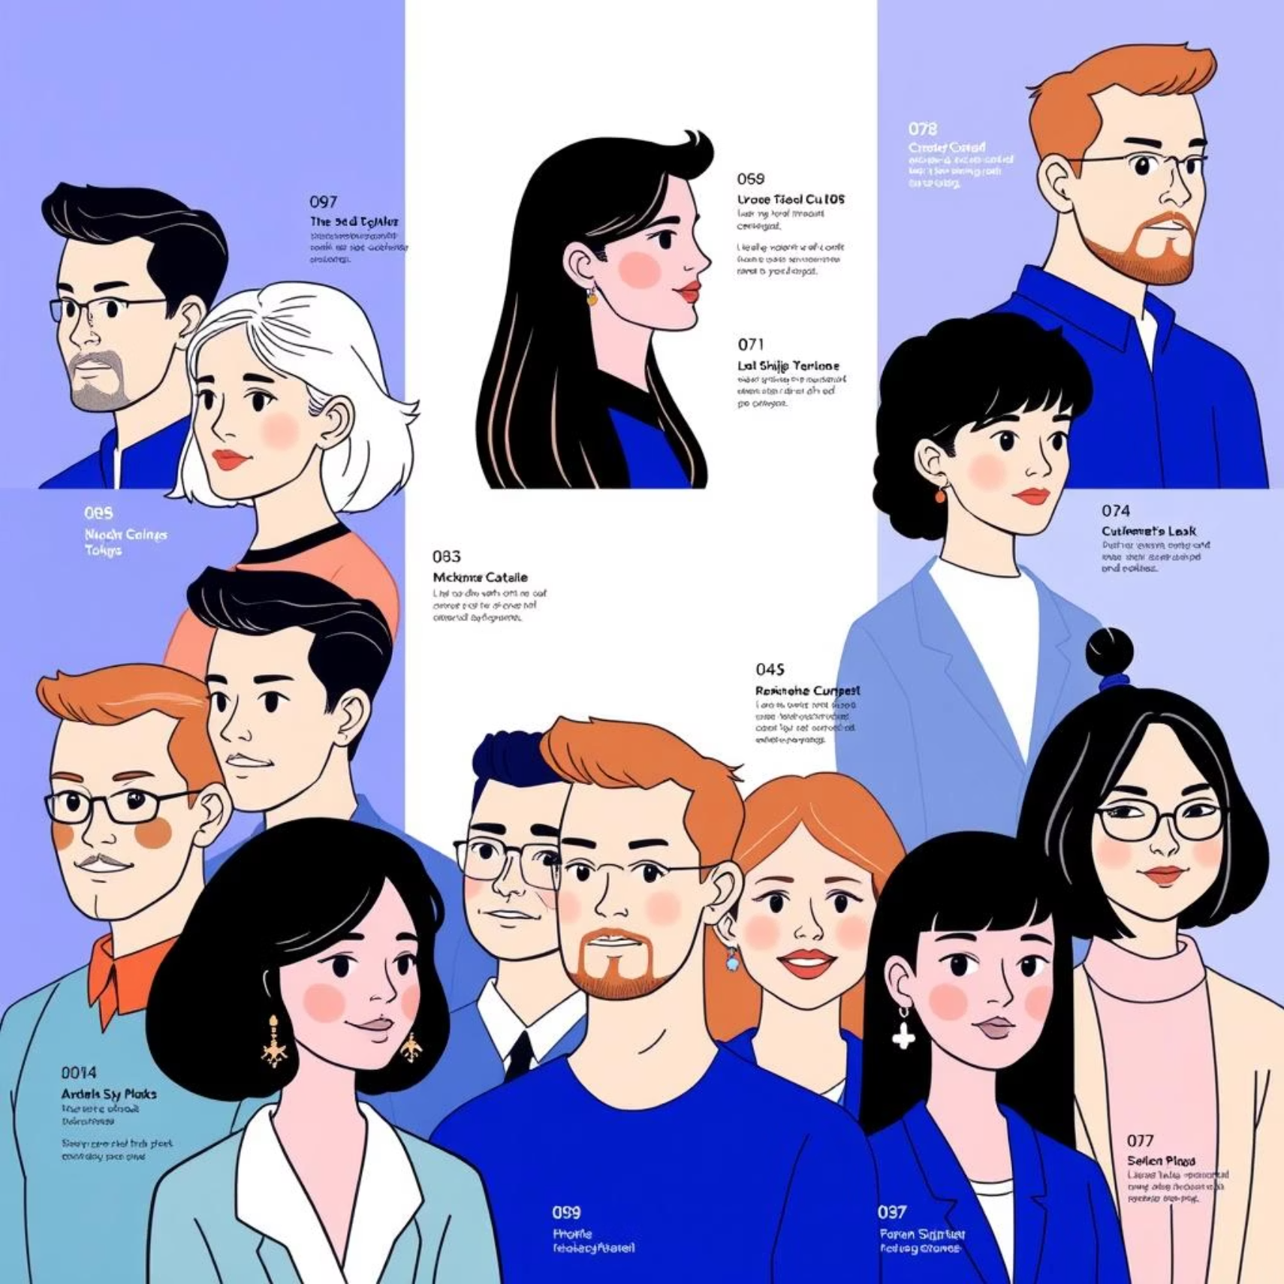
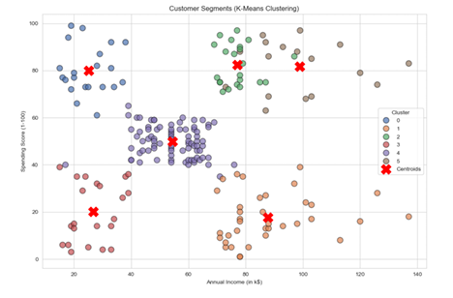
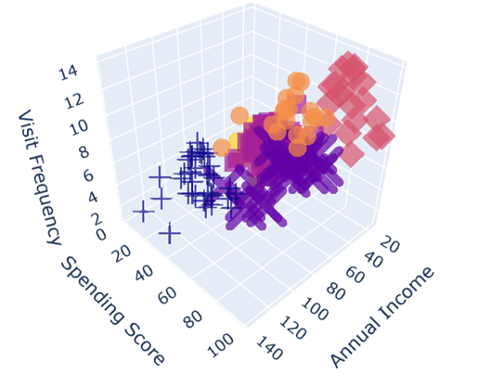
Segment Analysis and Persona Development
Visualization of Final Customer Segments &
Customer Persona Profiles
2D scatter plot of the six clusters using Annual Income and Spending Score with their centroids
3D view including Visit Frequency for a multi-dimensional perspective.
Cluster | Annual income | Spending Score | Visit Frequency | Age | Age group
4 | 85.84 | 82.58 | 12.63 | 32.05 | 26-40
1 | 87.20 | 81.70 | 8.35 | 33.30 | 26-40
3 | 24.95 | 81.00 | 10.95 | 24.85 | 18-25
2 | 54.12 | 49.90 | 6.52 | 42.25 | 41-60
5 | 26.73 | 20.05 | 2.86 | 45.86 | 41-60
0 | 87.72 | 17.61 | 3.00 | 41.17 | 41-60

Slide 13

Clusters 1 & 5: Affluent Spenders
High income ($77k–108k) and high spending. Frequent mall visitors, driving major revenue.
Cluster 4: Young High Spenders
Aged 18–25, lower income (~$25k) but very high spending on trendy, non-essential items.
Cluster 2: Core Customers
Average income (~$55k) and spending (~50). Stable, predictable shoppers forming the business backbone, representing the ”average” shopper.
Cluster 3: Budget-Conscious Segment
Low income (~$26k) with low spending (~21). Highly price-sensitive, focus mainly on essentialsgoods and value-driven purchases, visiting the least frequently of all segments.
Cluster 0: Discerning High Earners
High income (~$87k) but low spending (~18). This indicates significant purchasing power combined with a discerning and needs-based shopping behavior. They are not easily swayed by mass-market promotions

Slide 14

Conclusion
Built a complete ML pipeline with preprocessing, feature engineering, and clustering.
Three clustering algorithms were tested: K-Means, Hierarchical, and DBSCAN . The K-Means model gave the best performance with clear separation of clusters.
Personas ranged from Affluent Spenders to Budget-Conscious Shoppers.
DBSCAN revealed 44 anomalous customers, adding deeper insights.
Ultimately provides a data-driven foundation for Big Bazaar’s marketing strategy

